Slide 1

Email Spoofing: The Silent Threat in Your Inbox
By
Medishetty Manikanta Gandhi
22D41A6256
Cyber Security – A
Sri Indu College of Engineering and Technology
SICET GitHub : MKGandhi05 01

Slide 2




What is Email Spoofing?
Forging the sender's email address to look legit
Used in phishing, impersonation, and scams
No hacking required — just manipulation of email headers
SICET GitHub : MKGandhi05 02

Slide 3

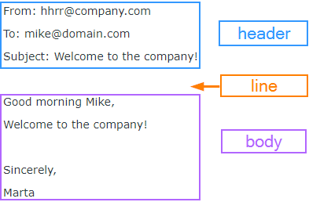


How Does It Work?
Emails are text-based: headers + body
Attackers change the “From” header
SMTP doesn't verify sender identity
Looks legit in inbox
, but it's fake
SICET GitHub : MKGandhi05 03

Slide 4



Live Demo Plan 🧪
Tools Used:
Python SMTP Library
Mailtrap (Safe email sandbox)
No real email accounts harmed
Demo shows spoofed email delivery
+
SICET GitHub : MKGandhi05 04

Slide 5
👉 Let’s Spoof an Email Live Demo Time!
SICET GitHub : MKGandhi05 05

Slide 6
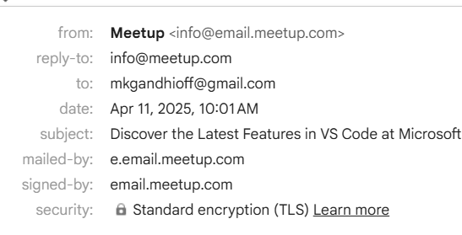
Detecting a Spoofed Email
Always inspect headers: “Return-Path”, “Received”, etc.
Look for mismatches in the actual sending domain
Gmail: Click “Show Original” → Analyze SPF/DKIM status
SICET GitHub : MKGandhi05 06

Slide 7
How to Prevent Email Spoofing?
Domain
Key Identified Mail
Sender Policy Framework
Domain
Based Authentication, Reporting and
Conformance
✅ SPF – Validates authorized IPs
✅ DKIM – Email is digitally signed
✅ DMARC – Tells receivers how to act if SPF/DKIM fail
✅ Works together to stop impersonation
SICET GitHub : MKGandhi05 07

Slide 8





🛡️ Stay Safe from Spoofed Emails
Don’t trust the name — verify the address
Use tools to check email headers
Be cautious of links & attachments
Report suspicious emails immediately
SICET GitHub : MKGandhi05 08

Slide 9



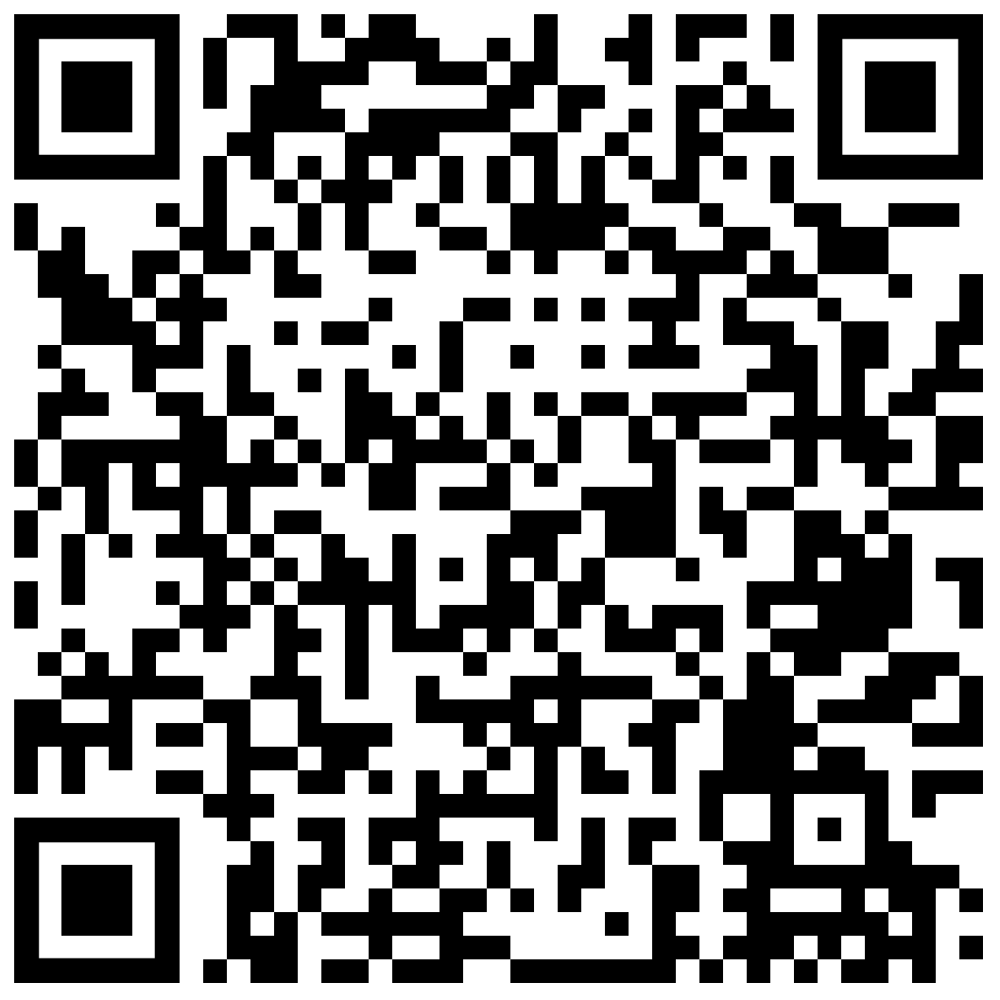
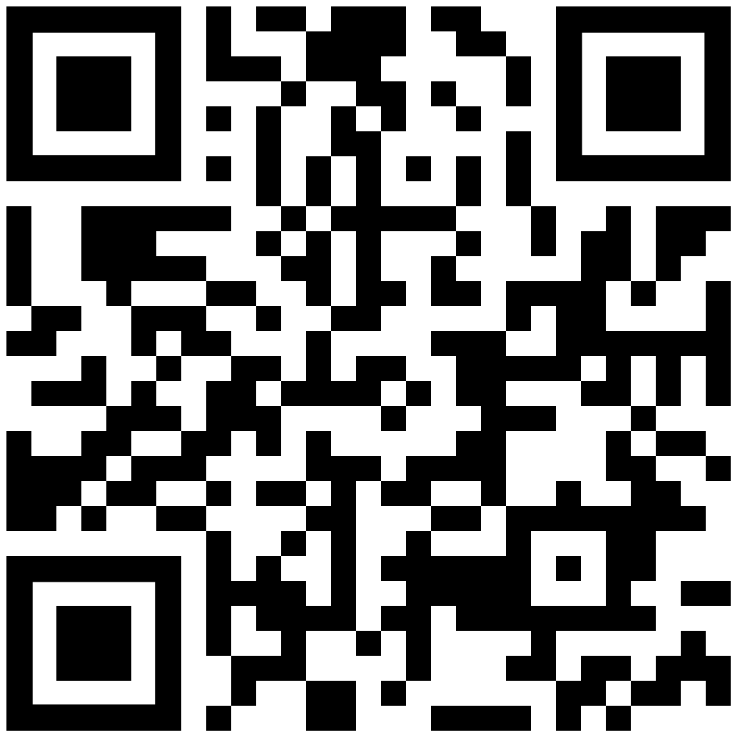
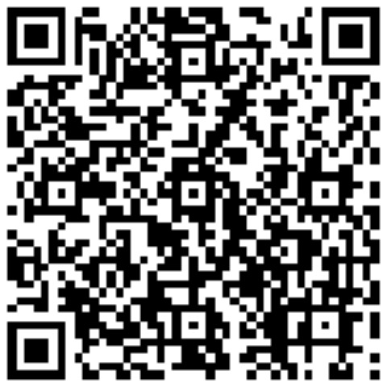
Thank You
SICET GitHub : MKGandhi05 09

